Slide 1


Team 27: GAN Assisted Map Reconstruction for first responders using Sensor Fusion
Quinn LeBoeuf, Rufus Tadpatri, Christian Jeardoe, Kyle Smejkal Sponsor: Swarnabha Roy TA: Niloofar Borzooei
Bi-Weekly Update 2
Notes:
Michelle

Slide 2
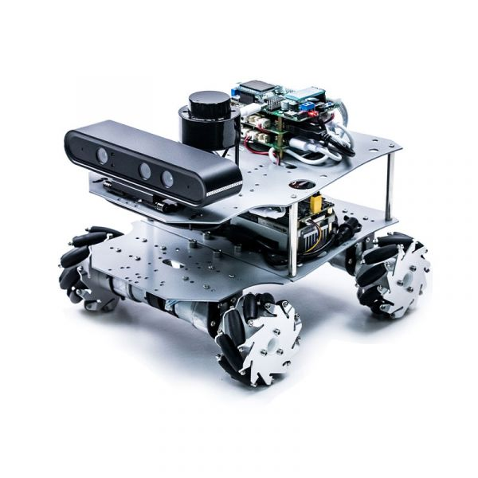
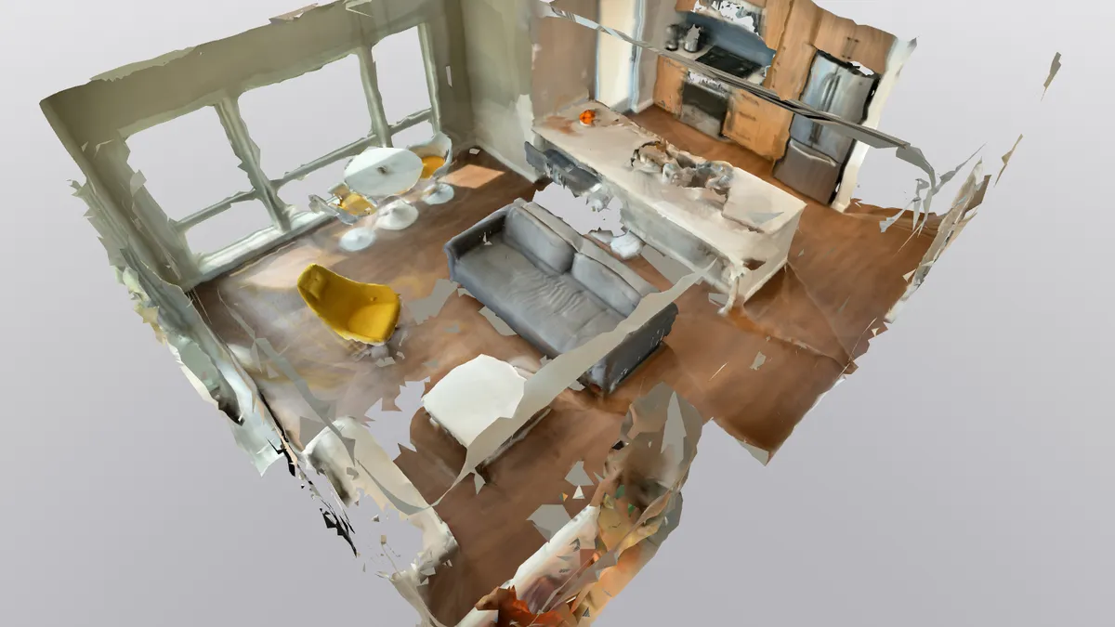
Project Summary
Emergency situations often require first responders to enter dangerous environments with minimal information (fires, gas leak, rescues)
Create a multi sensor, GAN assisted, map reconstruction program that can be utilized on a mobile platform to create a virtual 3D twin of any environment
Notes:
Kyle

Slide 3
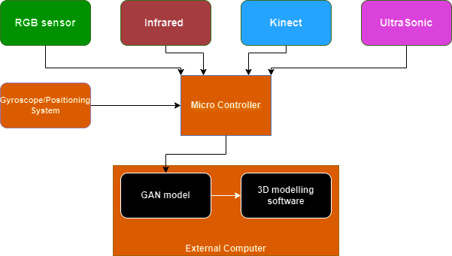
Project/Subsystem Overview
Rufus
Kyle
Christian
Quinn
LiDAR
Each subsystem has its required sensor inputting data into a GAN model and creating a 3D point cloud
GAN models vary in their tasks depending on the sensor
RealSense
IMU (Inertial Measurement Unit)
Notes:
Eric

Slide 4
Project Timeline
Subsystems Designs Updated and Additional Parts Ordered for Integration
(Completed 1/31)
Subsystems Refactored for Integration
(To Be Completed 2/12)
Integration of IMU in Unity Engine (To Be Completed 2/24)
Integration of Subsystems in Unity Engine (To Be Completed 3/31)
Combined Subsystems Unity Render Test
(To Be Completed 4/13)
Final Demo and Report (To Be Completed 4/21)
Notes:
Eric

Slide 5
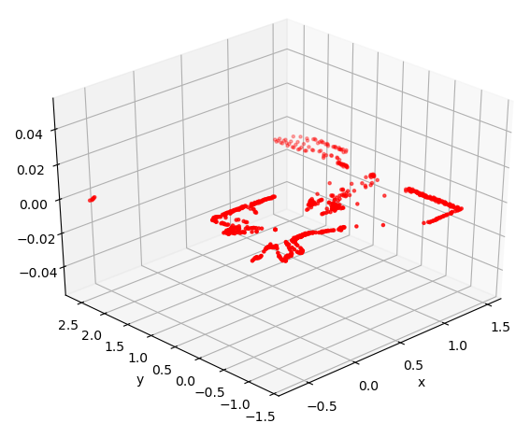
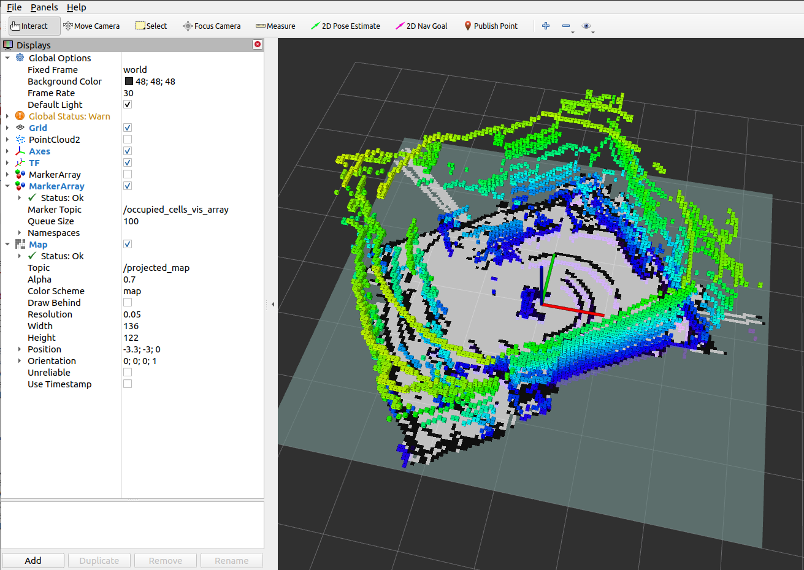
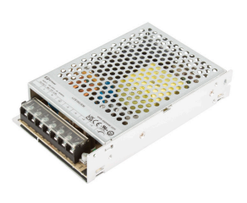

LiDAR SubSystem
Quinn LeBoeuf
Ongoing progress/problems and plans until the next presentation
Operation of LiDAR sensor (cables, power source) Preparation of software for LiDAR (SOPAS ET engineering tool) Changes in GAN model input/output data (untested) Issues in research for new training set By next presentation: fully functional sensor and GAN model that is integrated with Unity
Temporary Power Supply
(LCS150 Series)
Power Supply for Integration
(6s 22.2 volt lipo battery)
https://github.com/SICKAG/sick_scan_xd/blob/develop/doc/sick_scan_api/api_test_python_tim7xx.png

Slide 6
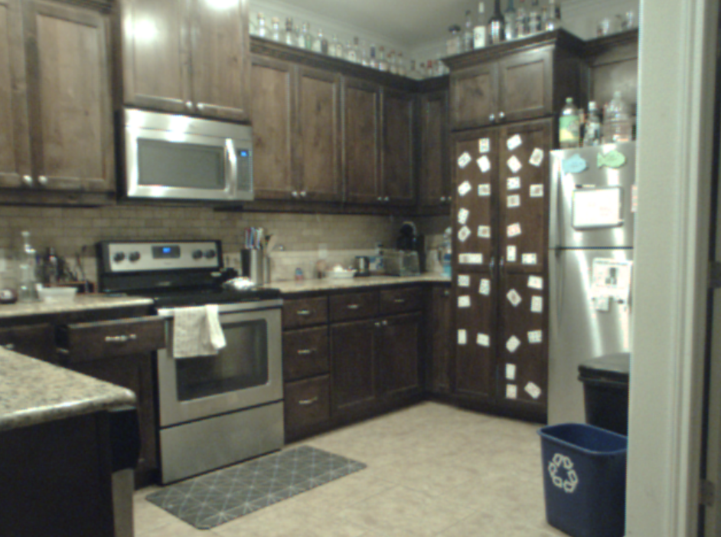
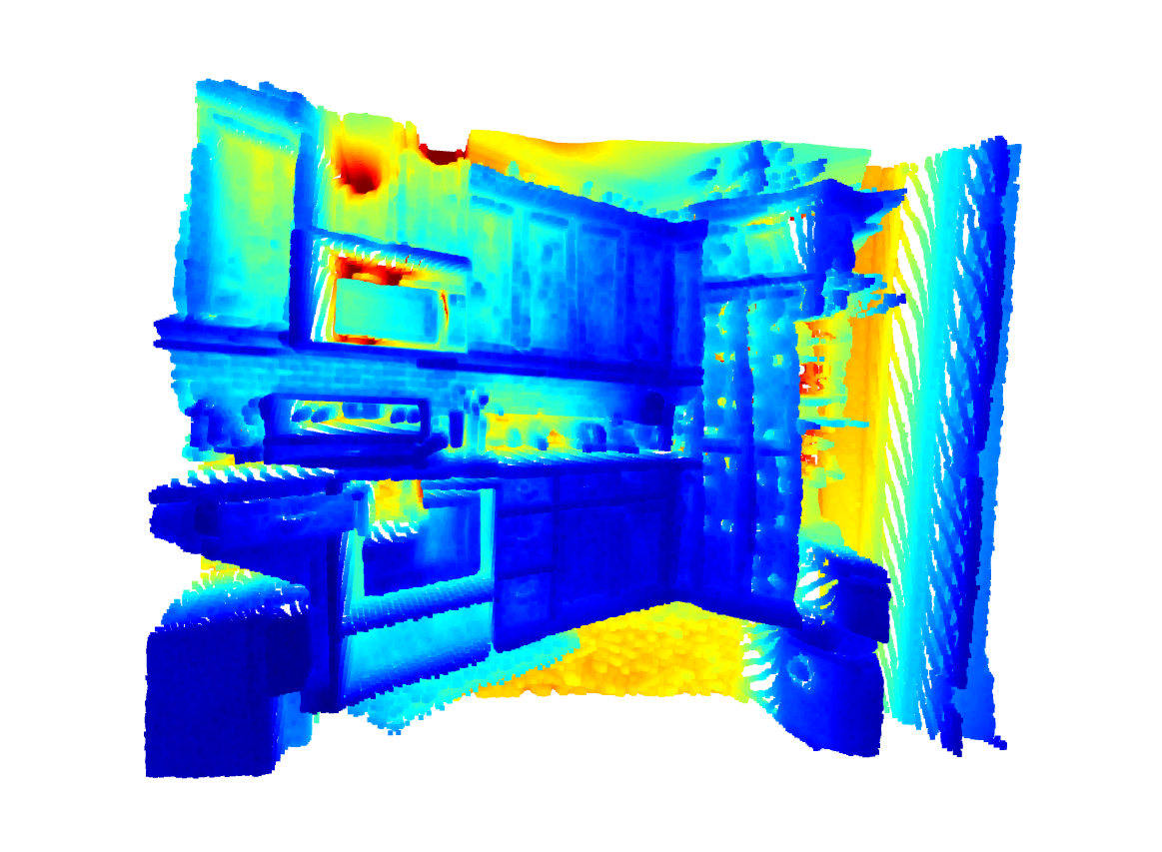
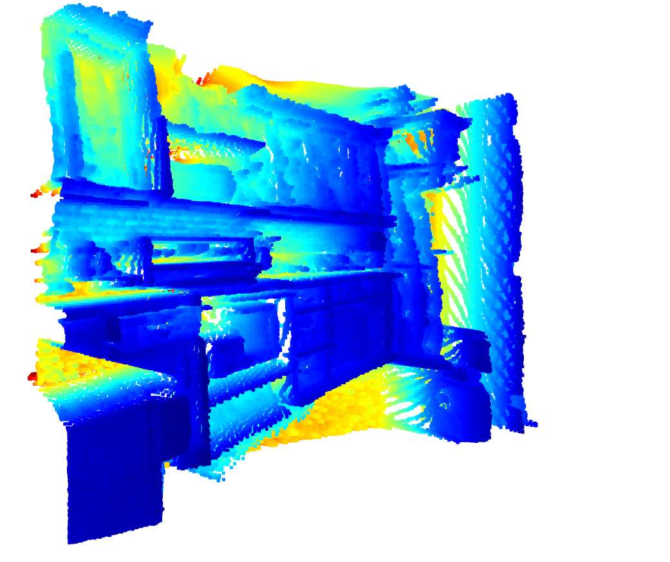
RGB Sensor Subsystem
Rufus Tadpatri
Accomplishments since last update (10 hours) | Ongoing progress/problems and plans until the next presentation
Testing of subsystem for preparation of integration Preliminary work in Unity to understand environment | Integrate subsystem into Unity engine
Further GAN testing:

Slide 7
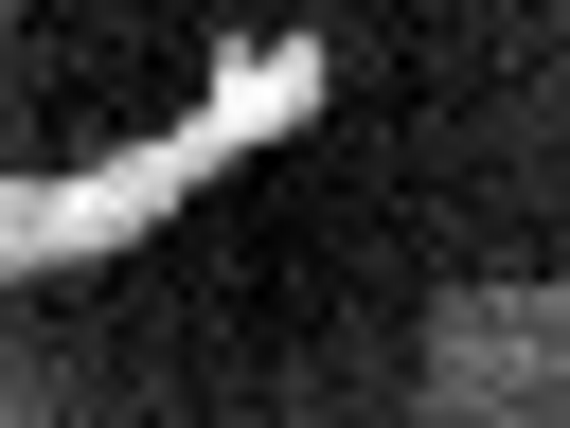
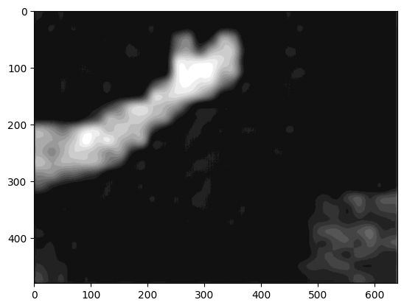
Infrared Sensor SubSystem
Kyle Smejkal
Accomplishments since last update (13 hours) | Ongoing progress/problems and plans until the next presentation
Ordered new sensor with higher resolution Generate from base image Set new device to train model | Low resolution Inefficient point cloud Create variance in training data Image formatting for point cloud generation
Original Image
Generated Image

Slide 8
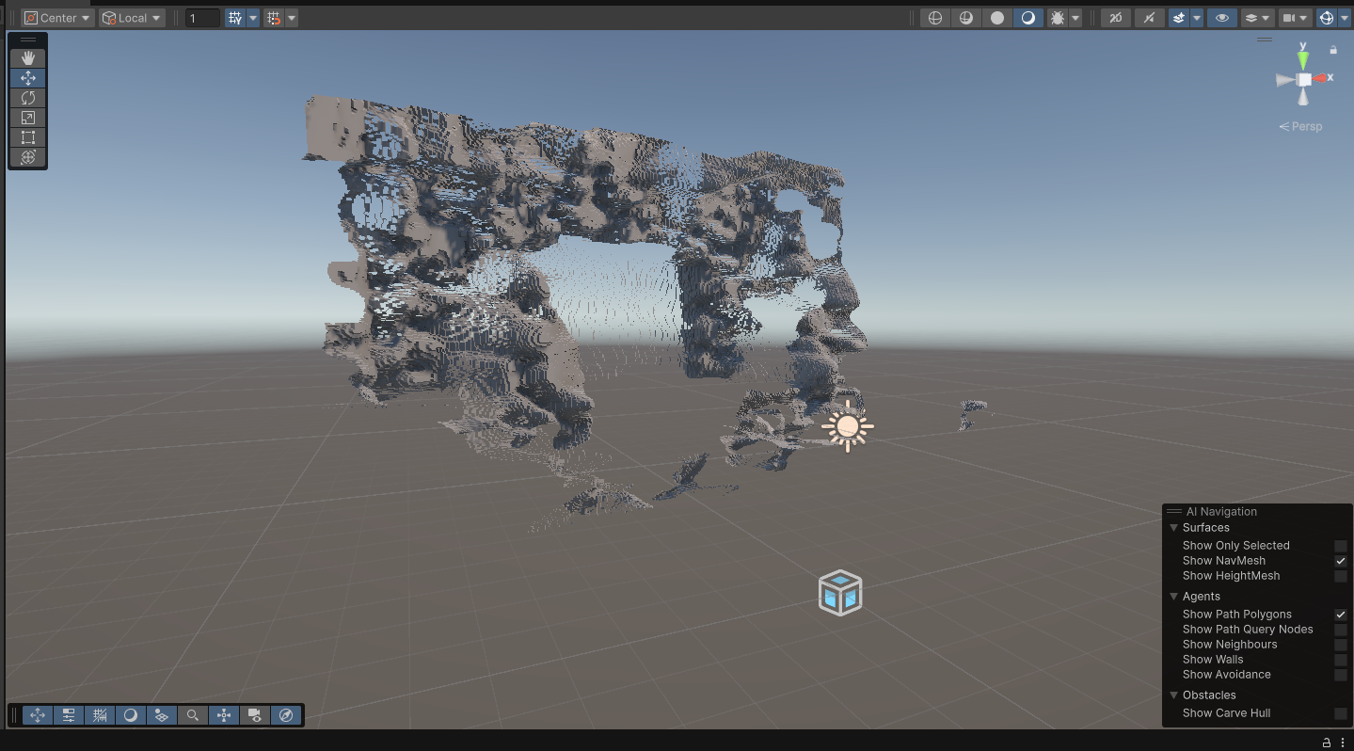
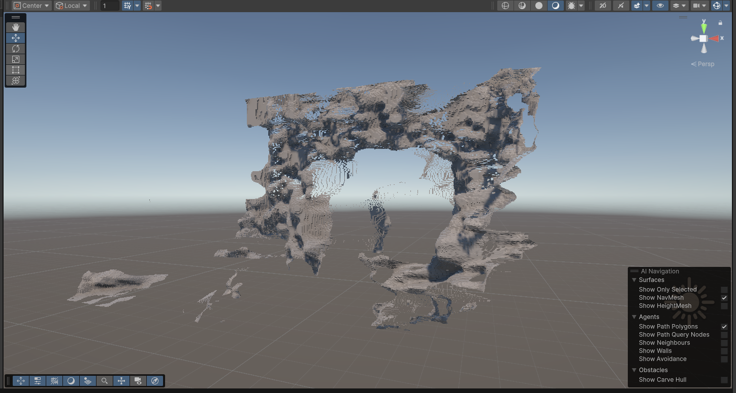
RealSense SubSystem
Christian Jeardoe
Accomplishments since last update (23 hours) | Ongoing progress/problems and plans until the next presentation
Refactored subsystem workflow so sensor input flows directly in to GAN model and a point cloud is generated (18 hours) Setup and test Unity environment for integration (5 hours) | Integrating subsystem input into Unity engine Waiting on IMU to deliver Should have IMU integrated by next review

Slide 9
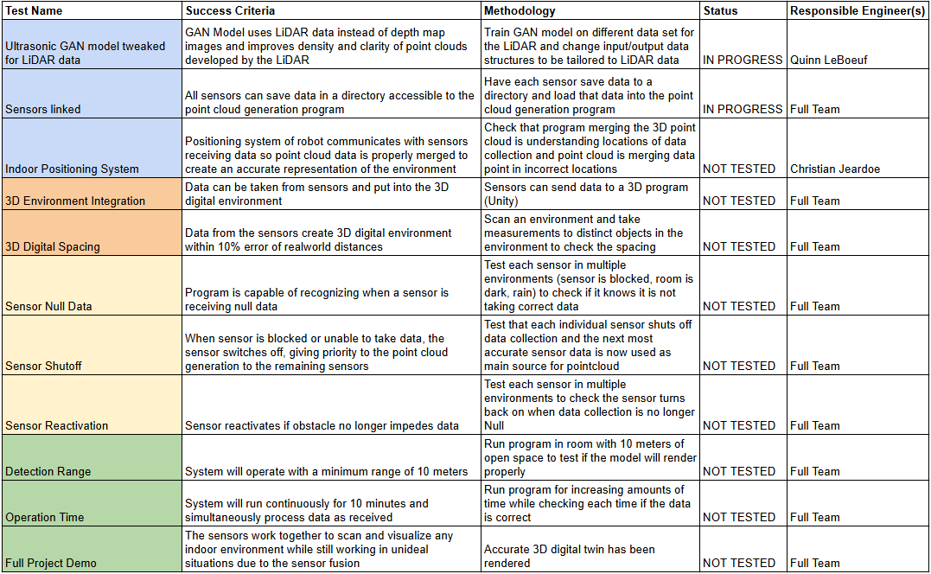
Validation Plan
Notes:
Michelle

Slide 10
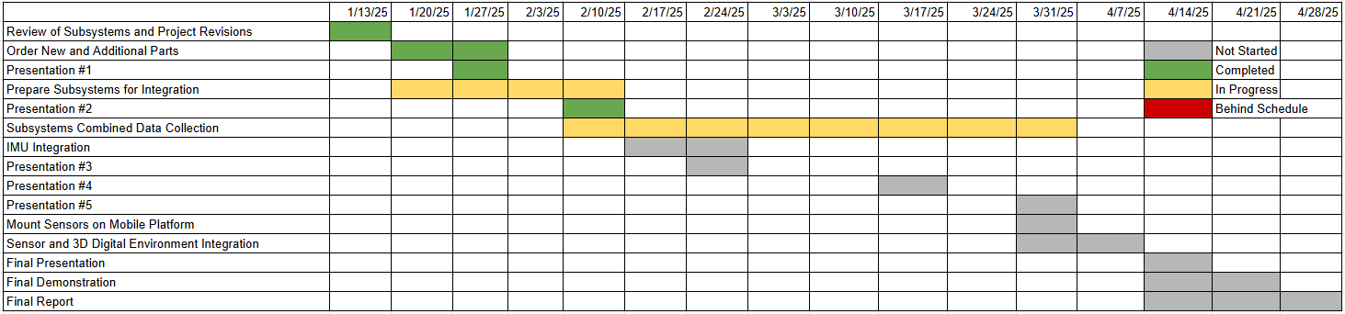
Execution Plan

Slide 11
Thank you for your time

